Slide 1



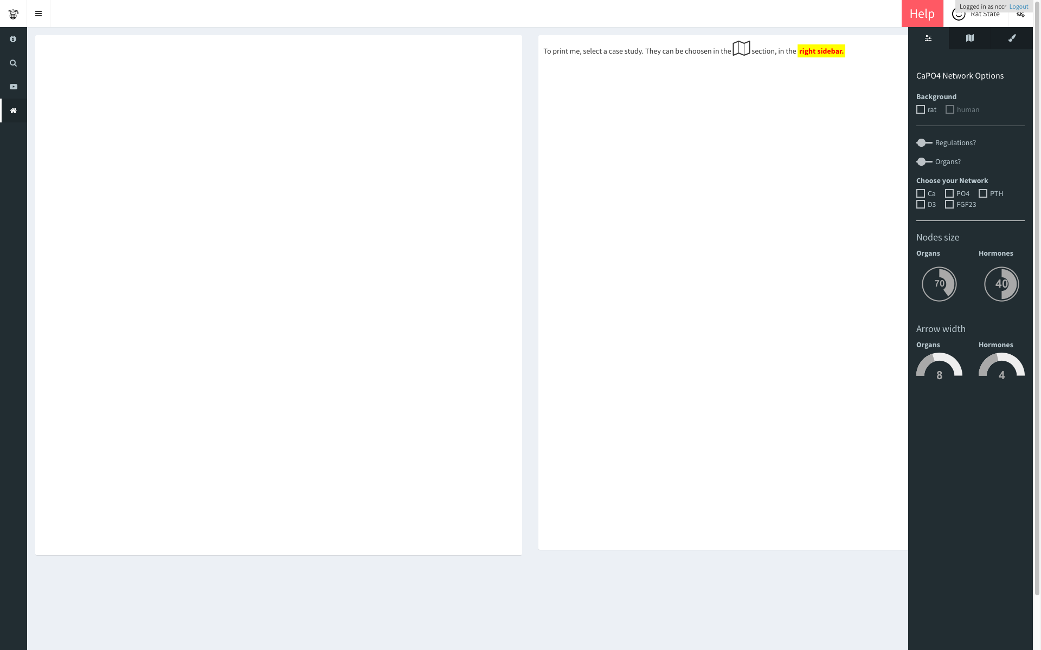
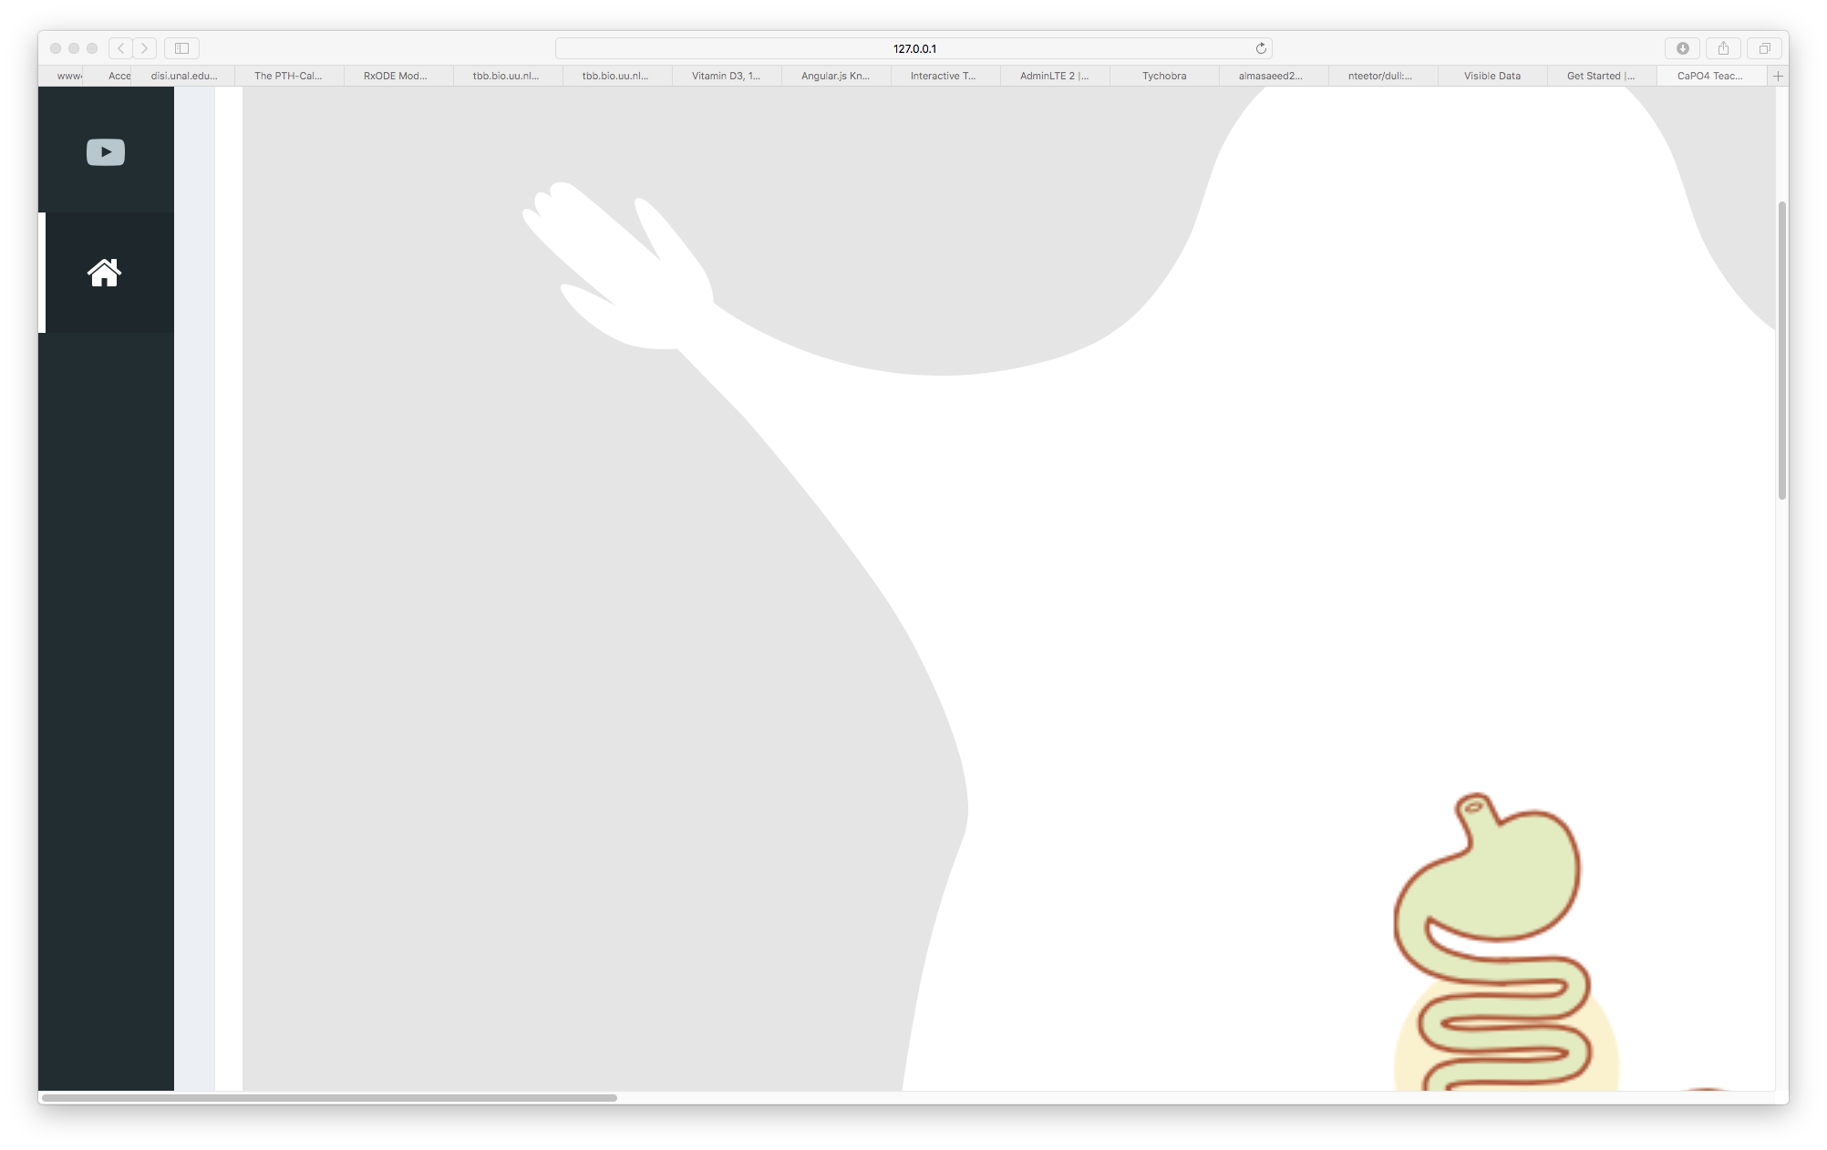
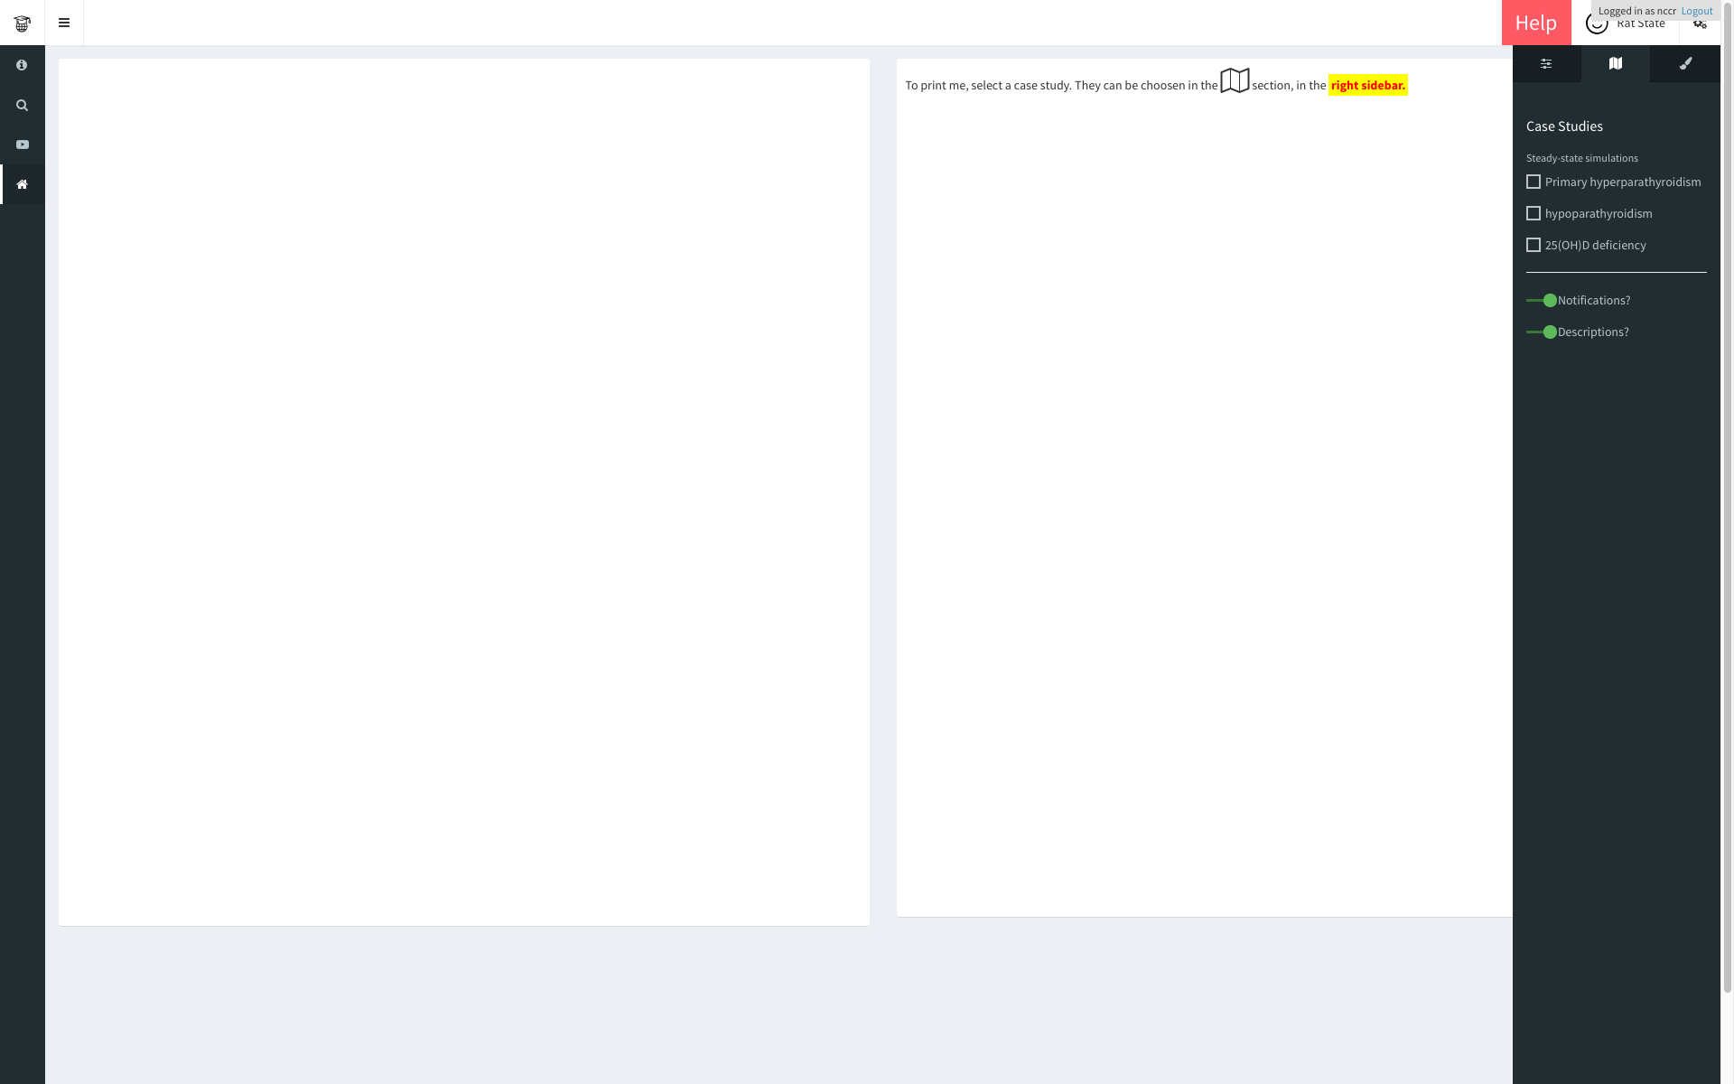
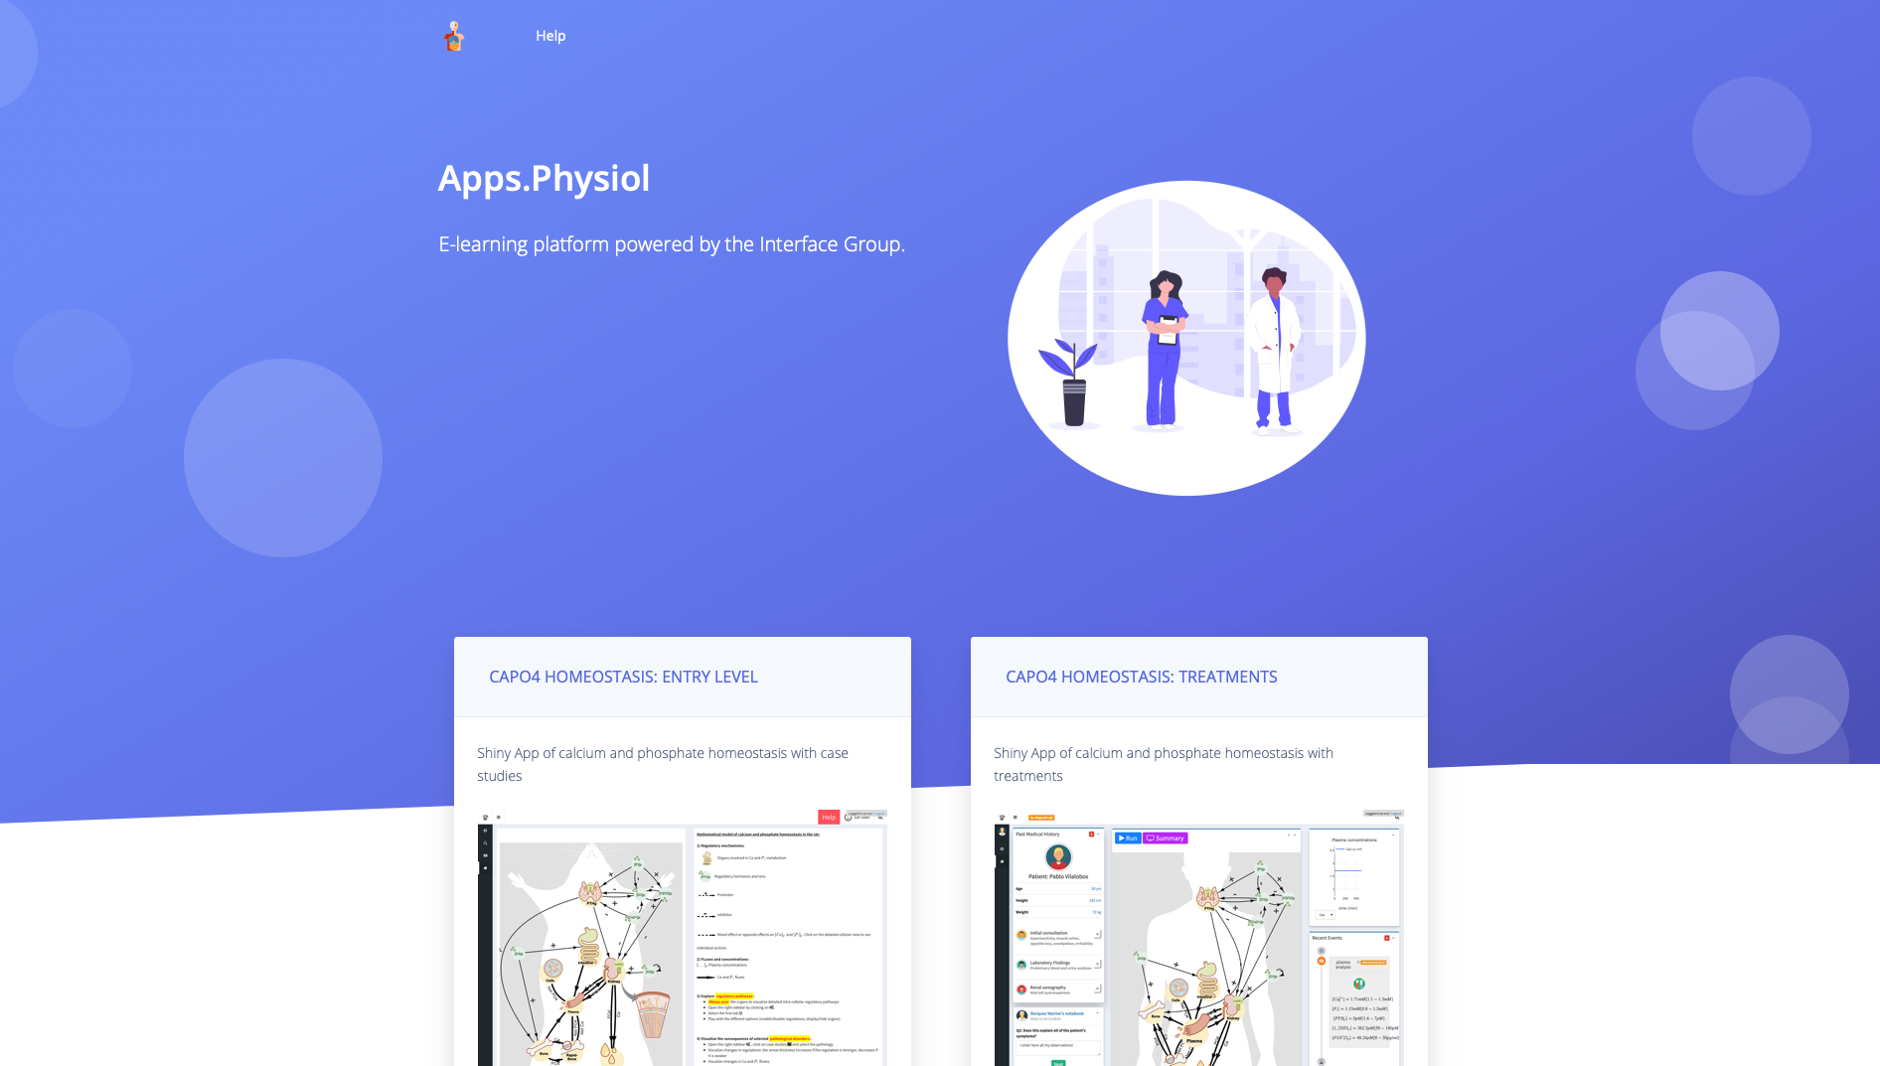

CaPO4 entry level App: : CHEAT SHEET
(2) Navigation Menu
(3) Basic options
Navigate in the Panels,
the main application is
1. Choose a background
2. Choose whether to display hormonal regulations (dotted arrows)
3. Filter elements (Ca²⁺, PO₄³⁻ as well as hormones)
(1) Access
4. Control node/edge size (optional)
http://physiol-seafile.uzh.ch
(4) Case Studies
1. Select a case study (6 choices)
2. Enable/disable help texts (optional)
The Interface Group, Zurich • David Granjon • dgranjon@ymail.com • http://physiol-seafile.uzh.ch/ • Updated: 2019-02

Slide 2
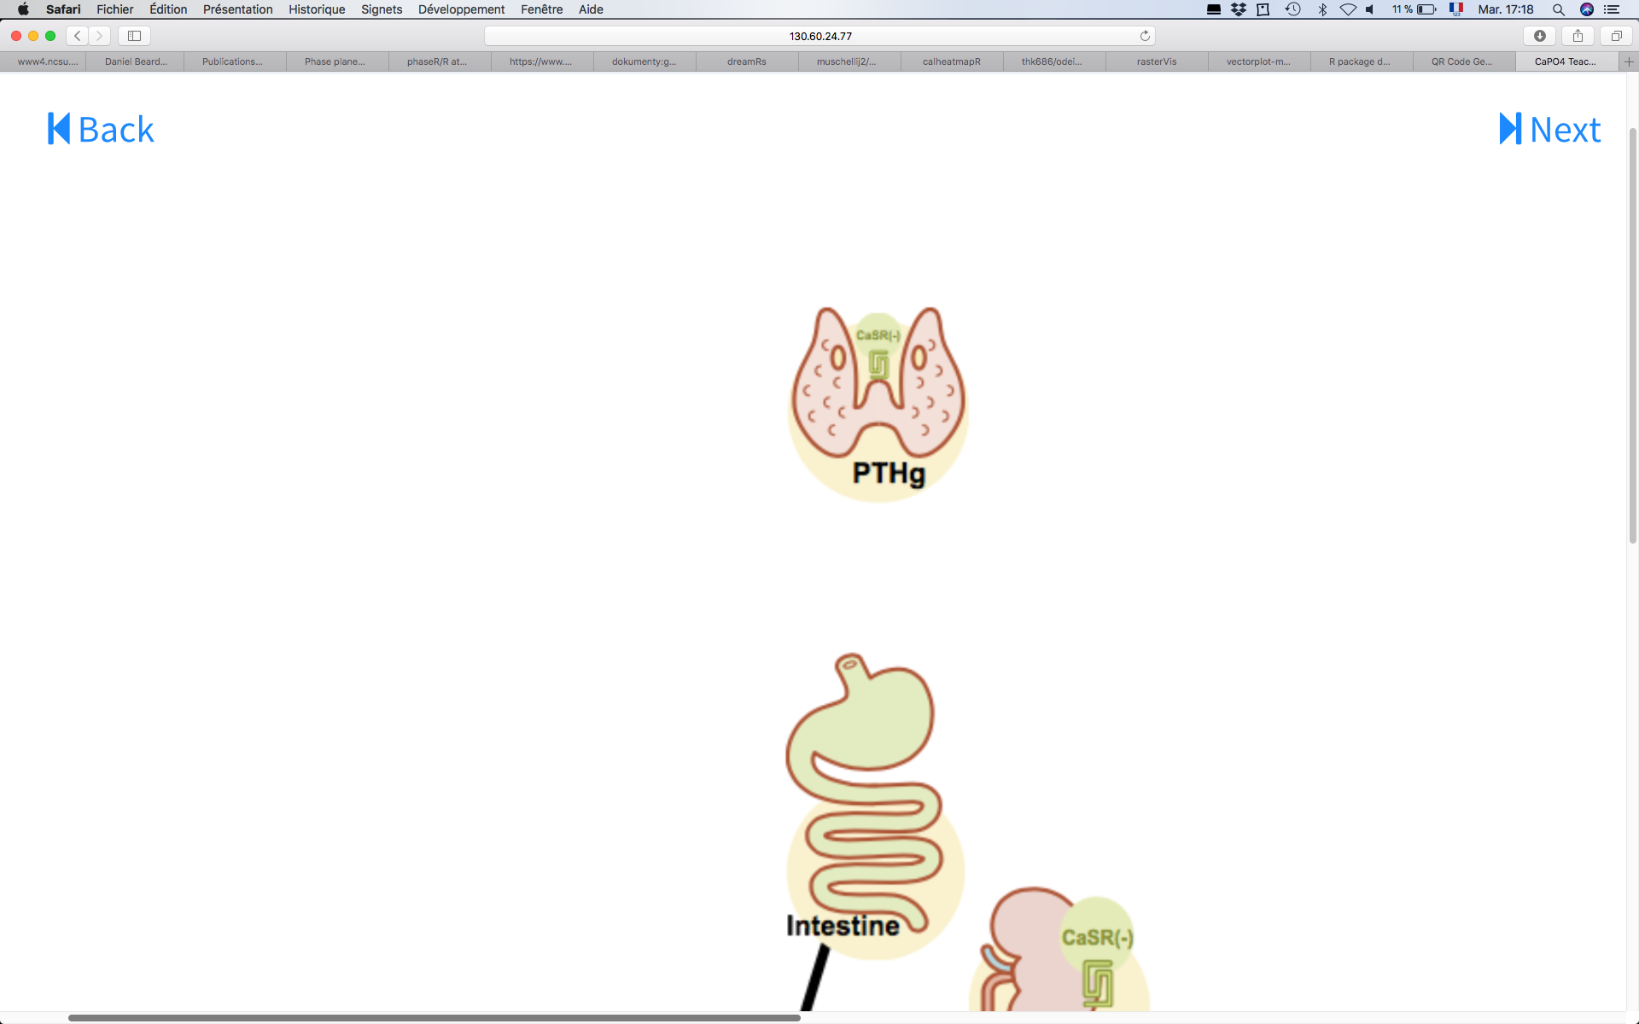
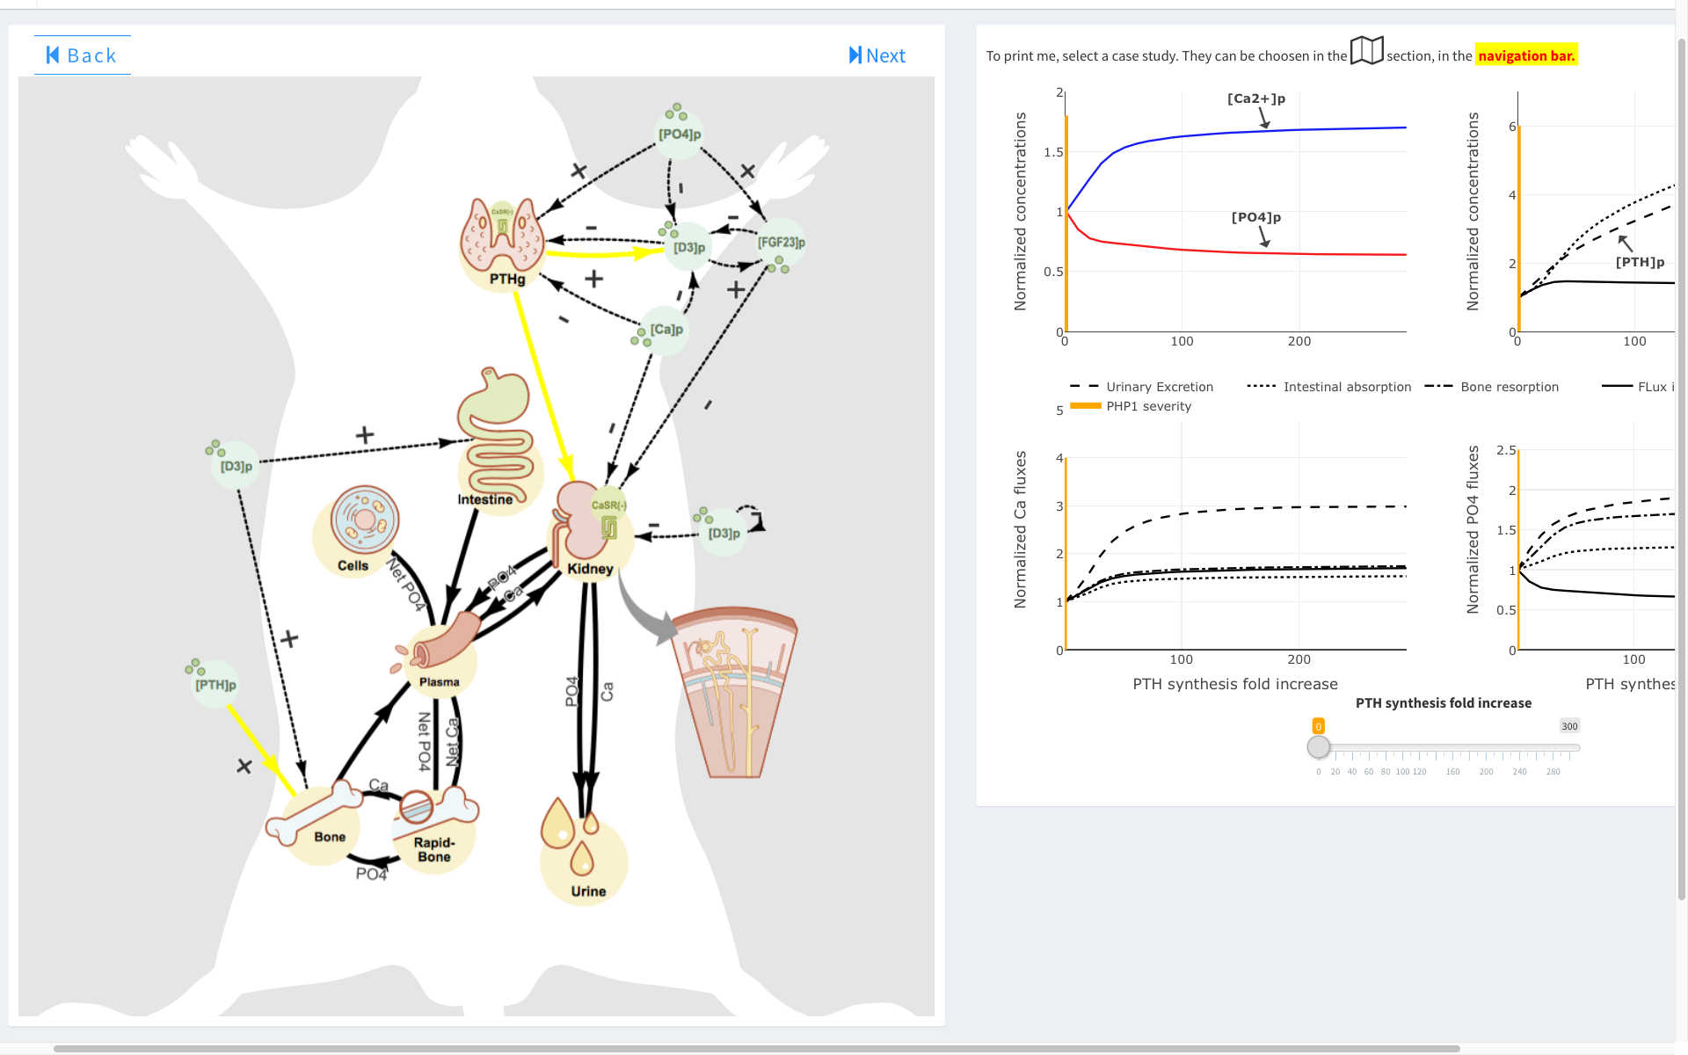
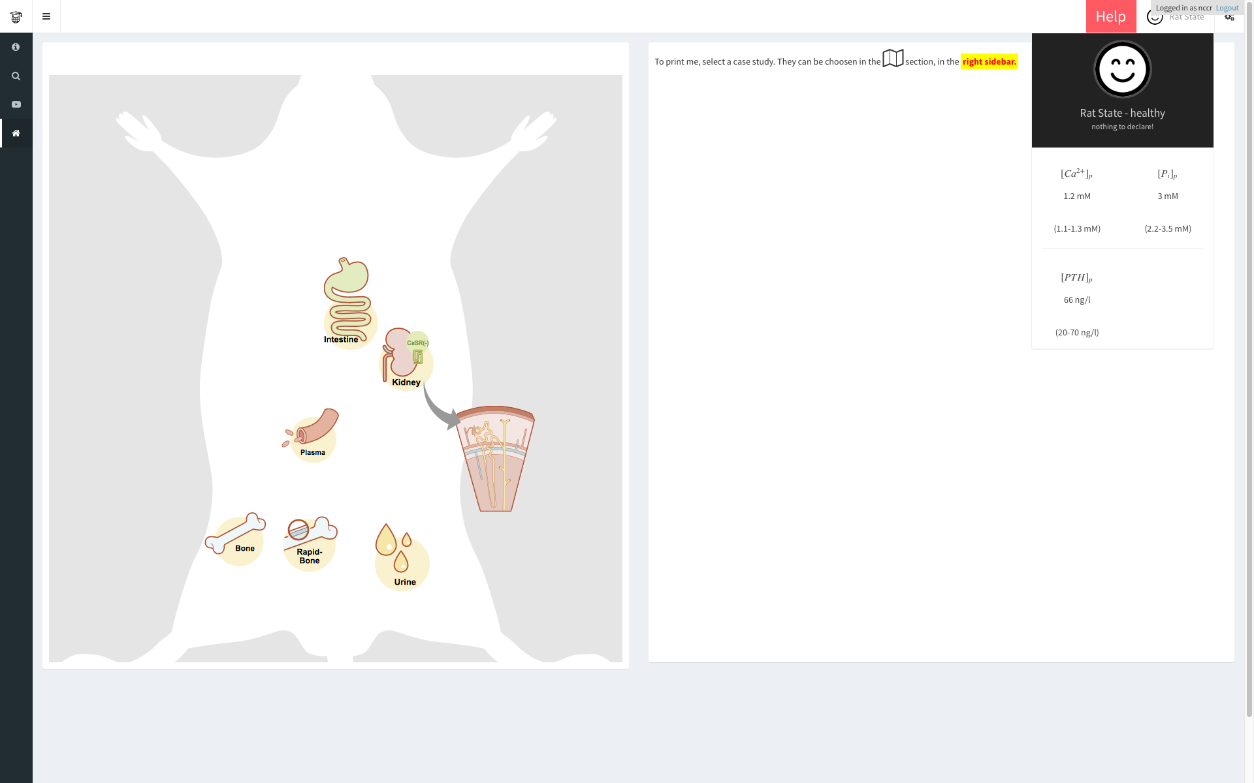
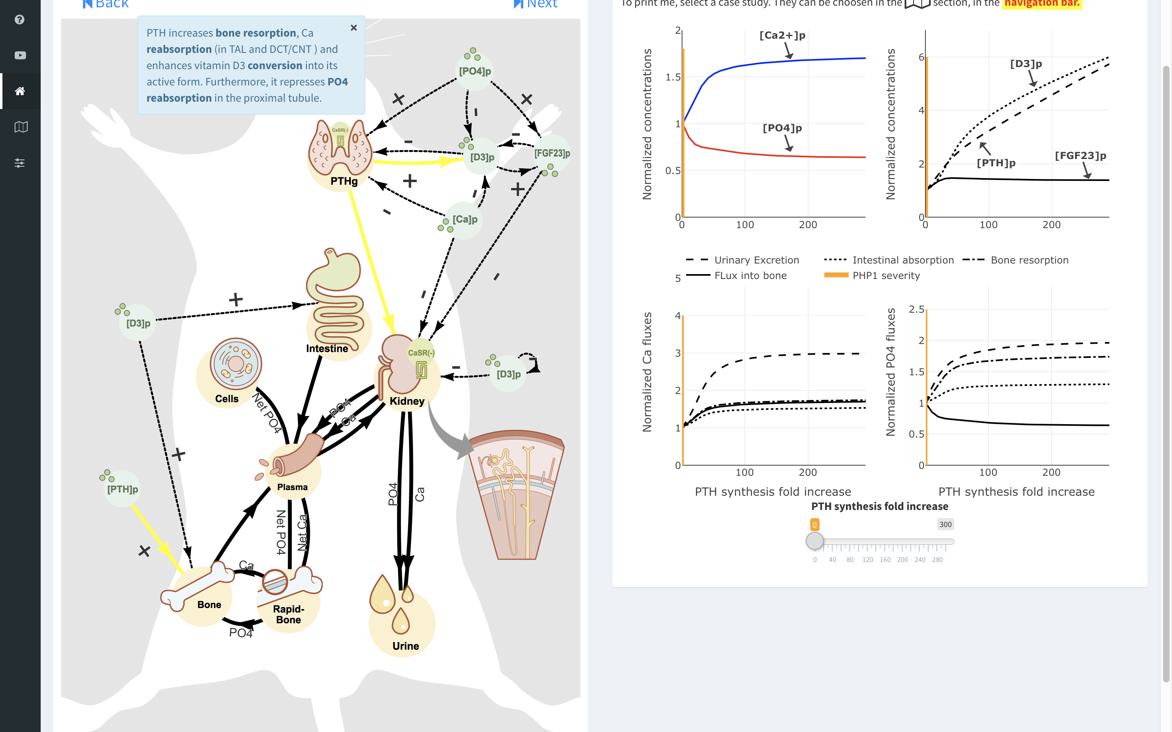
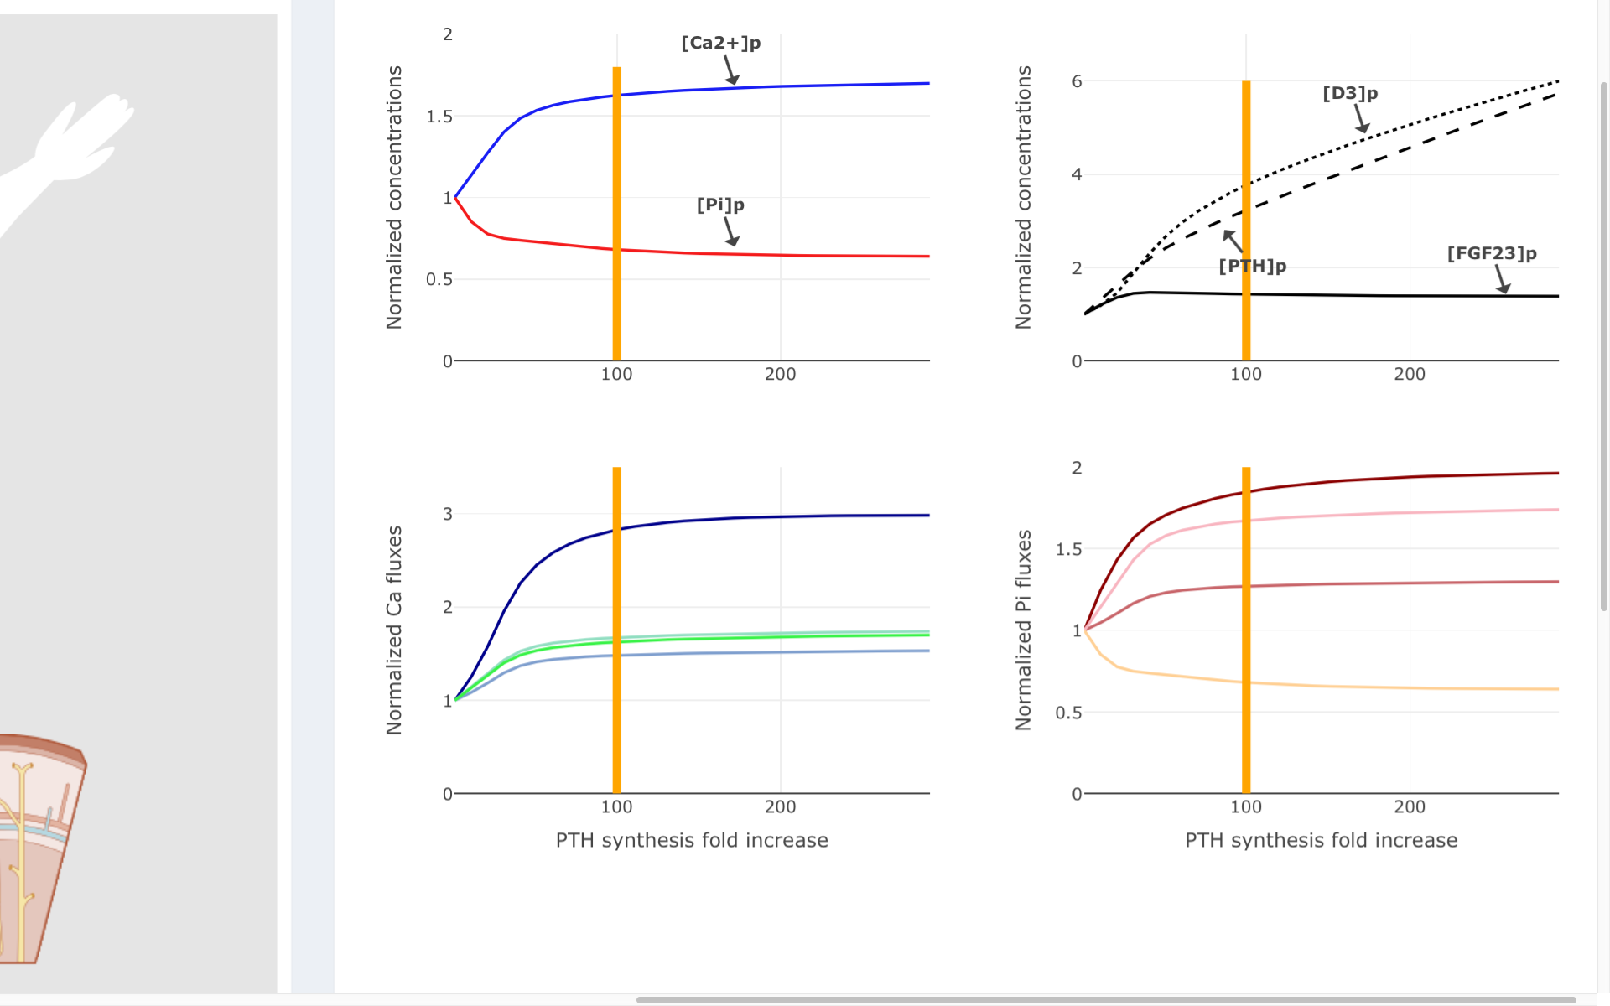
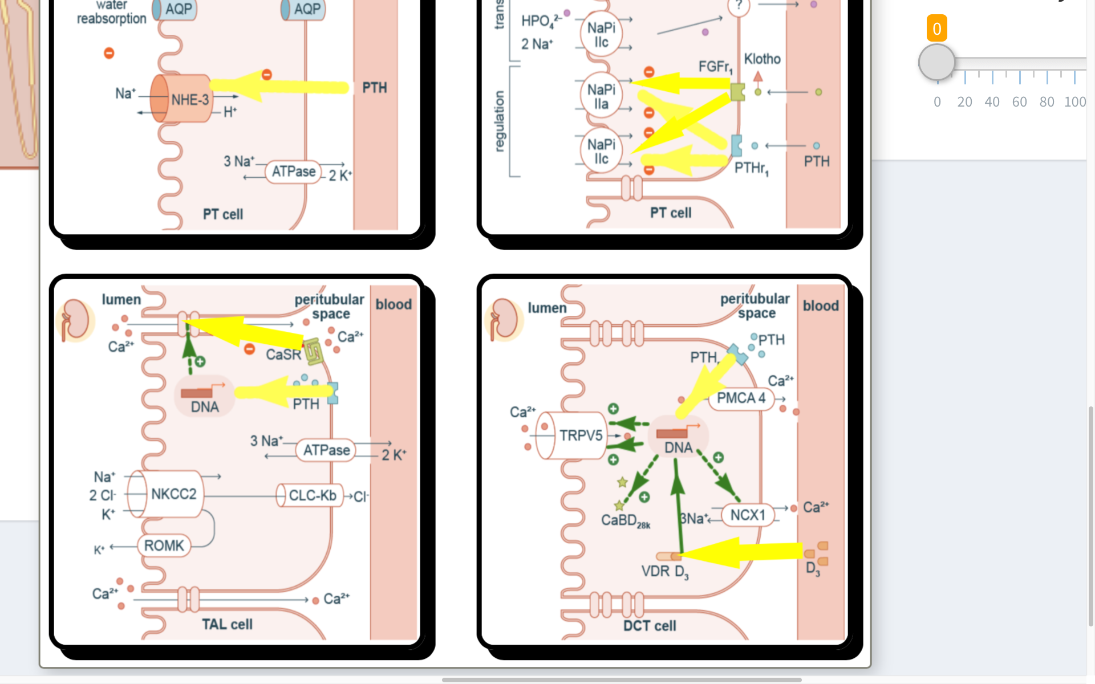
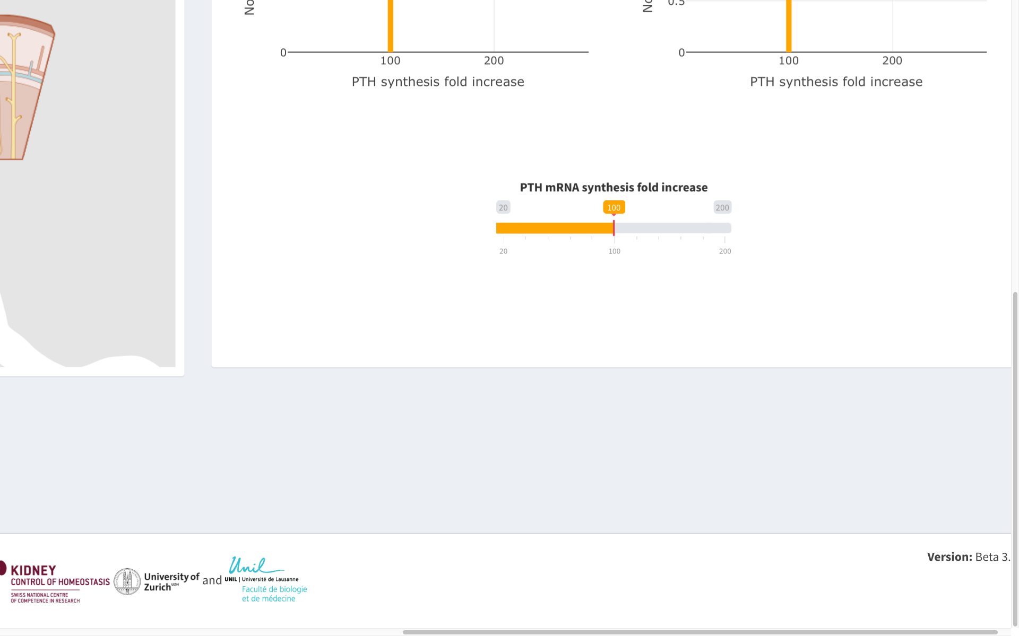
(5)Visualization
1. Pop-up notifications explain the sequence of events highlighted in yellow
5. Check your patient/rat status: healthy, sick or dead.
2. Click on the navigation buttons to cycle through the consequences of the selected dysregulation
4. Visualize the simulated steady state concentrations and fluxes associated with the disease severity
3. Hover over organs for a detailed view of the cellular perturbations
5. Control the severity of the disease
The Interface Group, Zurich • David Granjon • dgranjon@ymail.com • http://physiol-seafile.uzh.ch/ • Updated: 2019-02

